Slide 1
Integrating DefectDojo with JIRA
Kim, Sanghyoun
AWS Professional Services

Slide 2
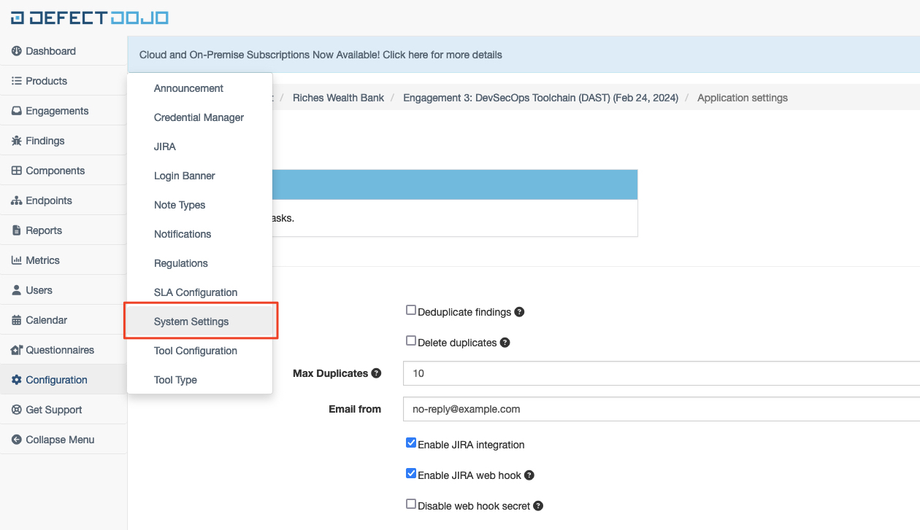
(DefectDojo) Incoming Webhook

Slide 3
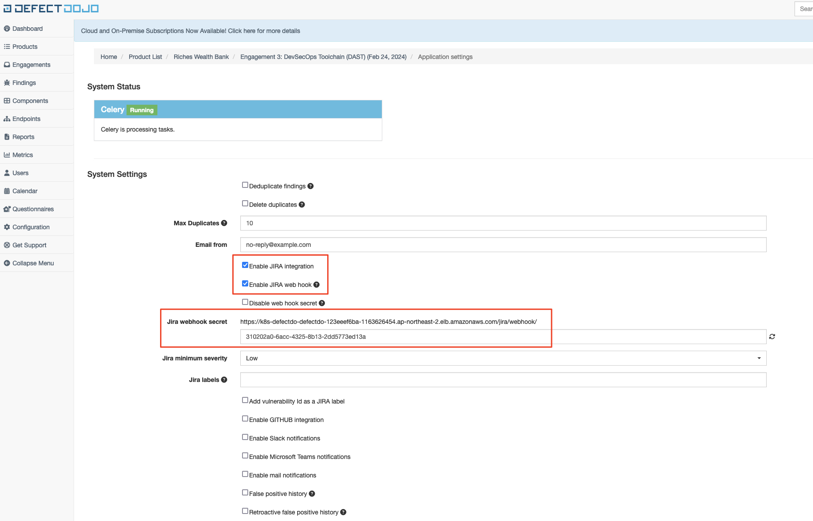
(DefectDojo) Incoming Webhook

Slide 4
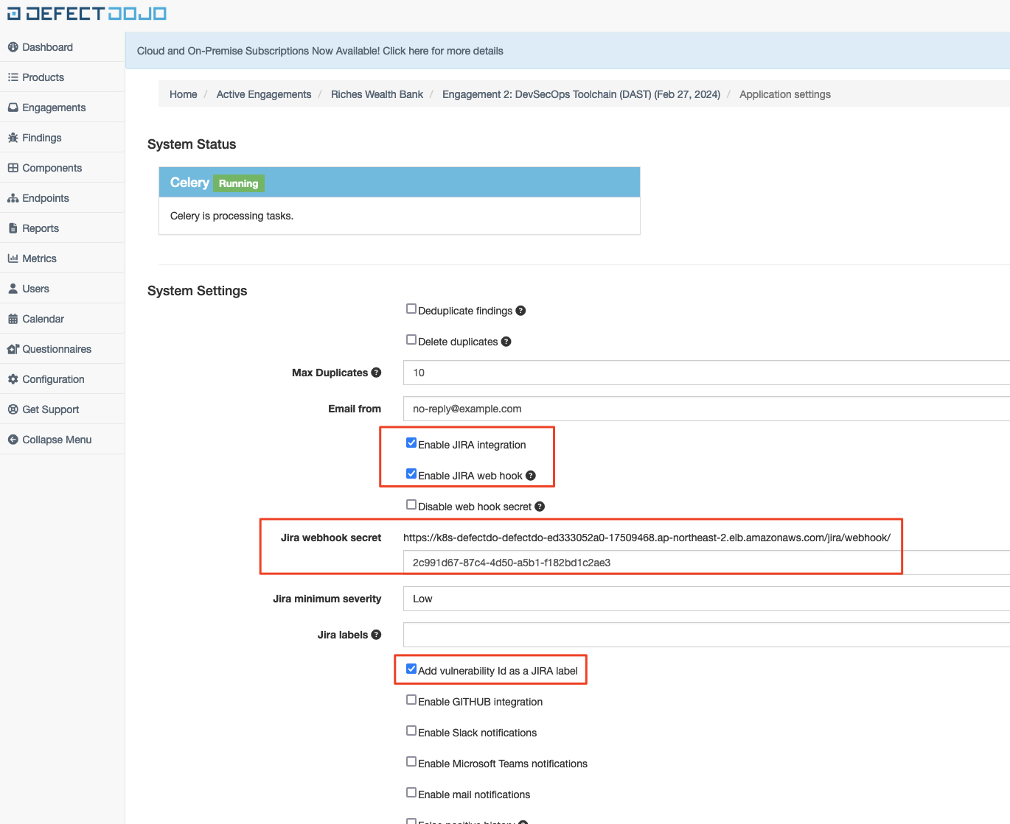
(DefectDojo) Incoming Webhook

Slide 5
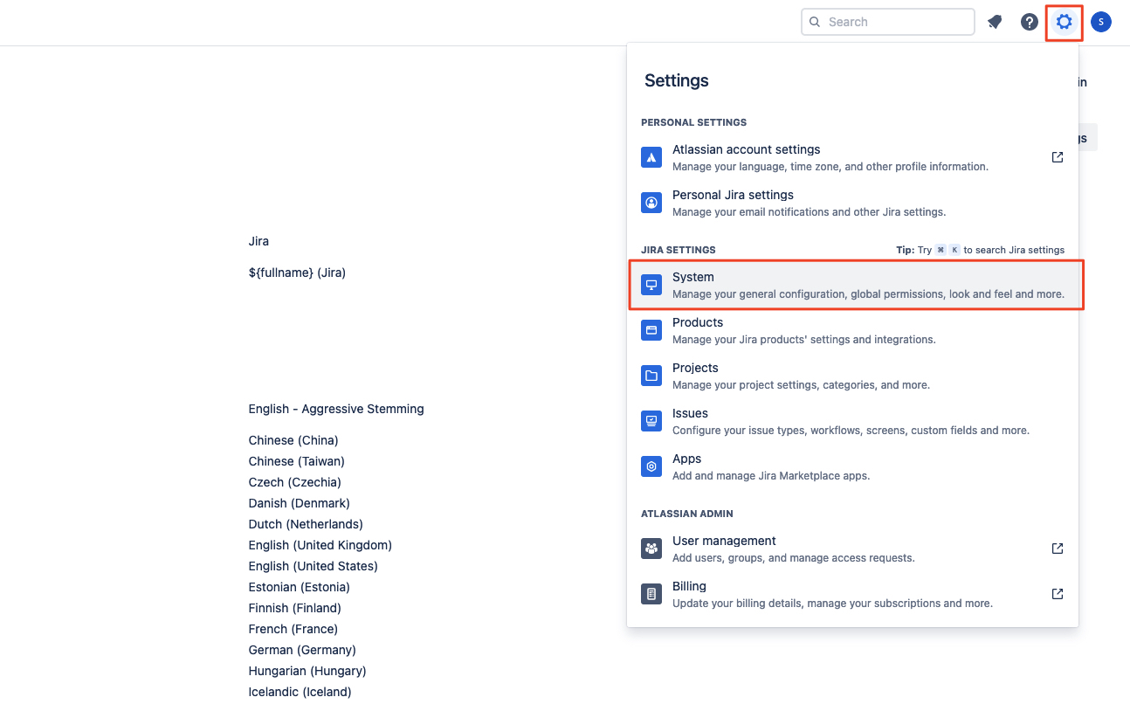
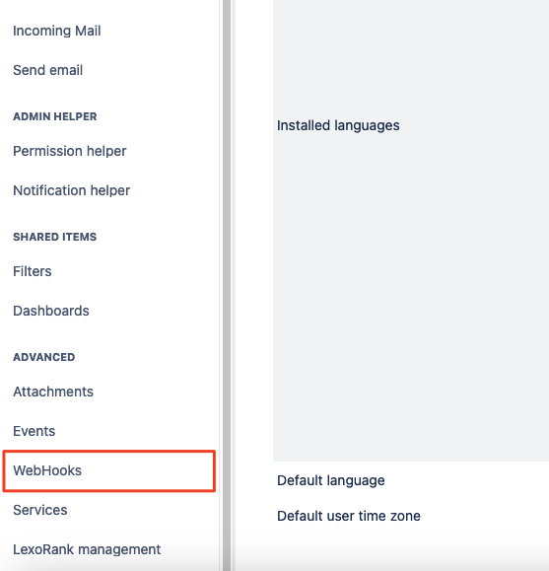
(JIRA) Outgoing Webhook
https://defectdojo.github.io/django-DefectDojo/integrations/jira/#enabling-the-webhook

Slide 6
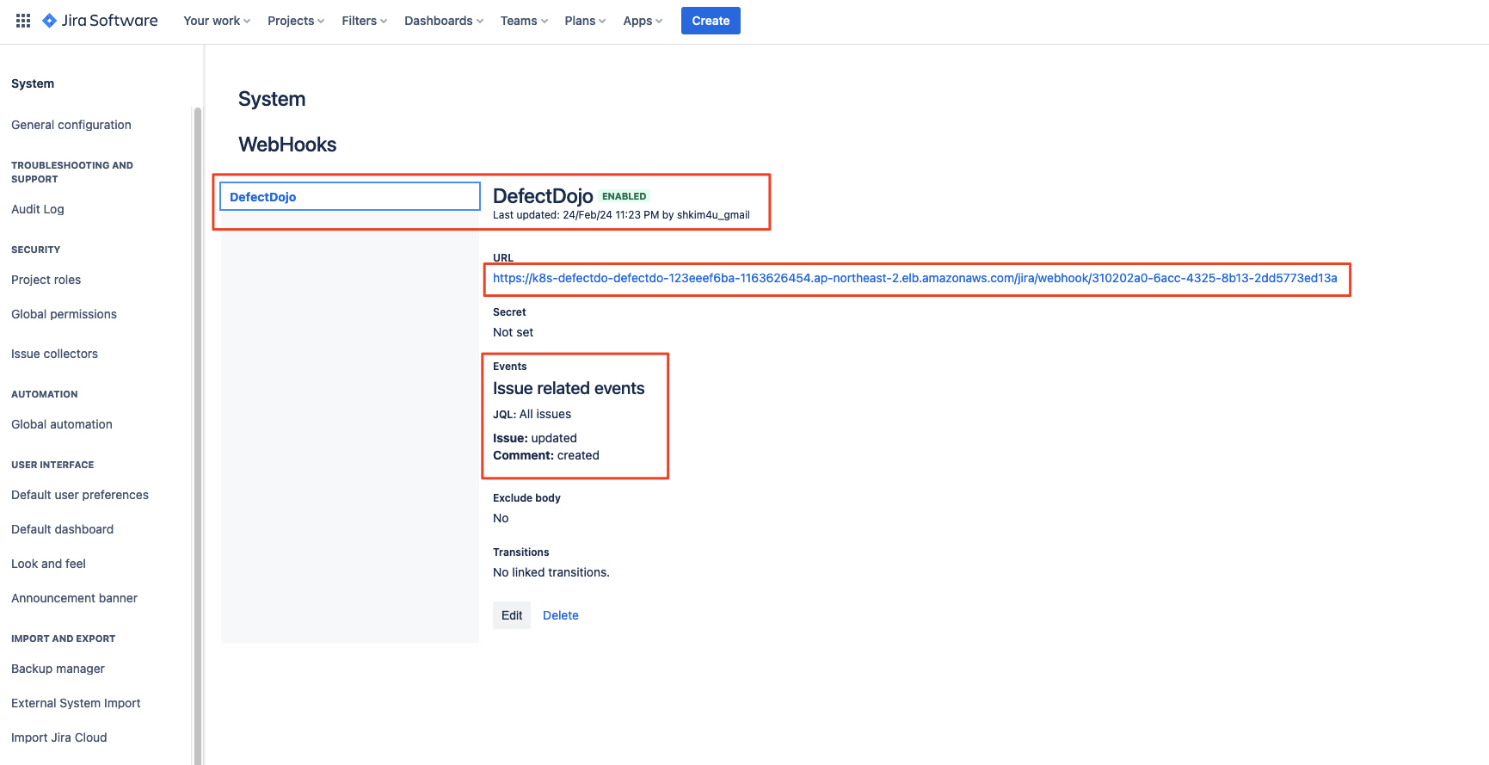
(JIRA) Outgoing Webhook

Slide 7
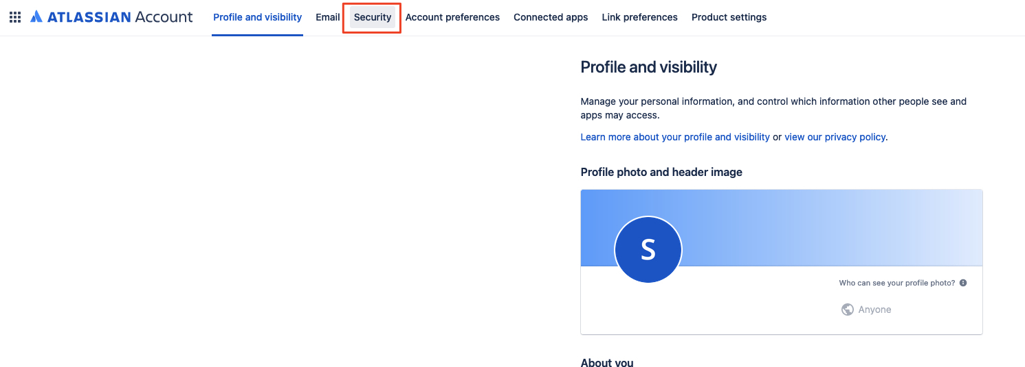
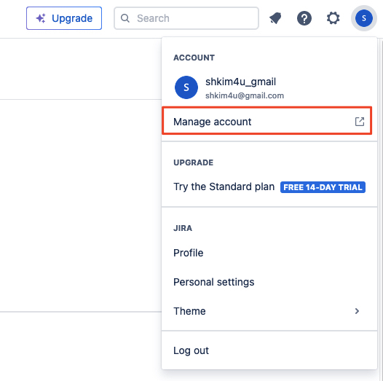
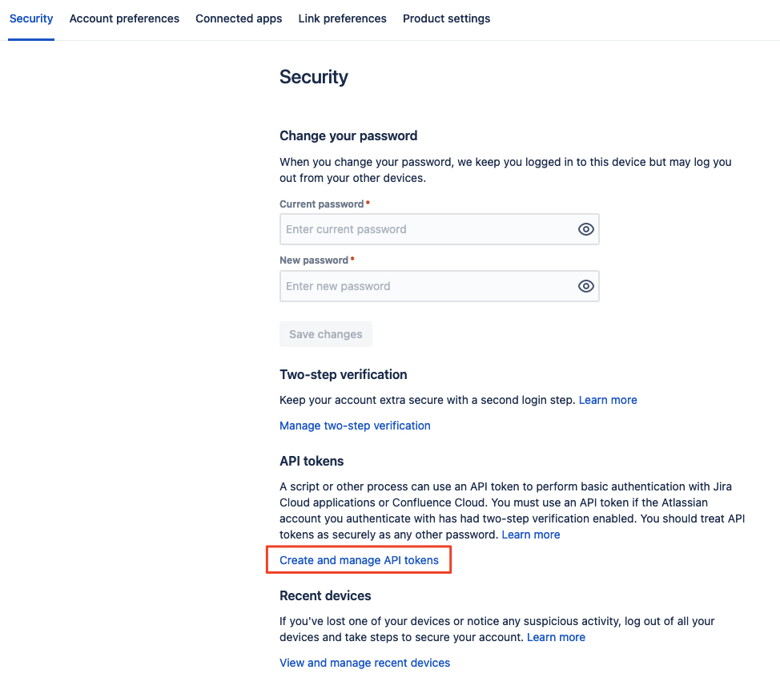
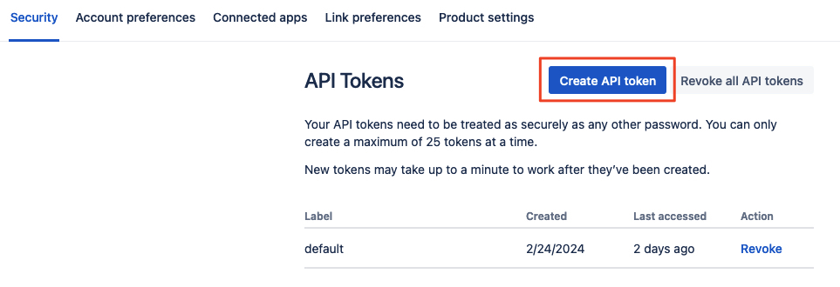
(JIRA) Create API Token
https://<id>.atlassian.com/manage-profile/security/api-tokens

Slide 8
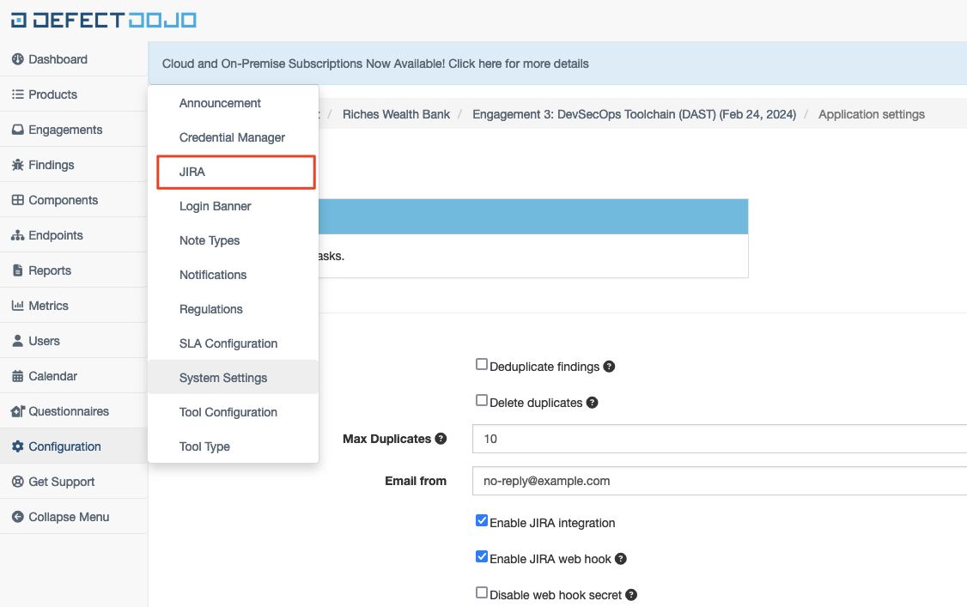
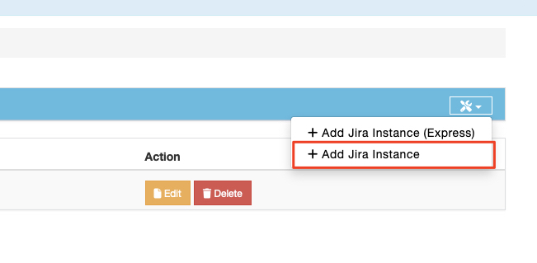
(DefectDojo) JIRA API Invocation Settings

Slide 9
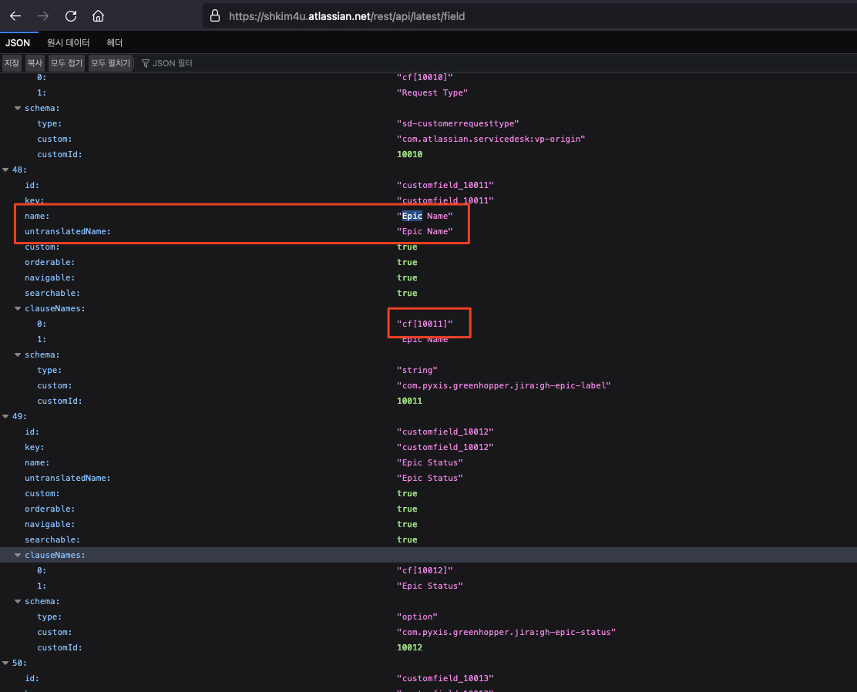
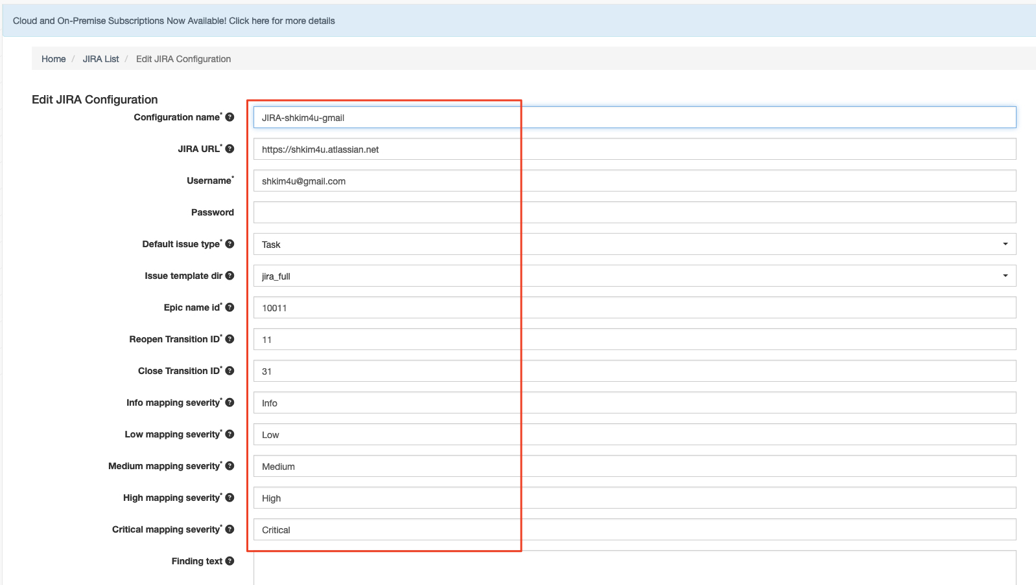
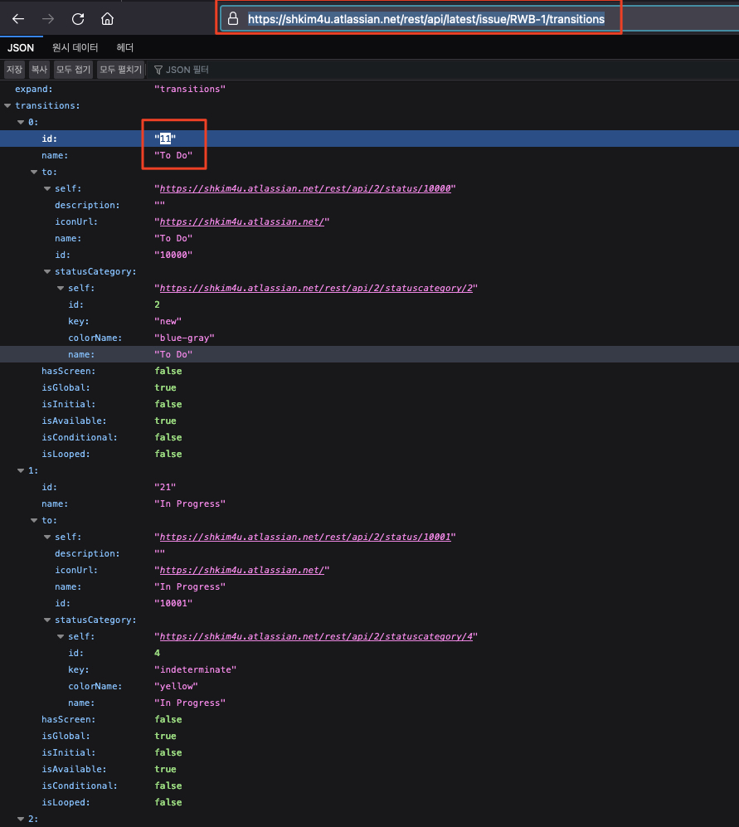
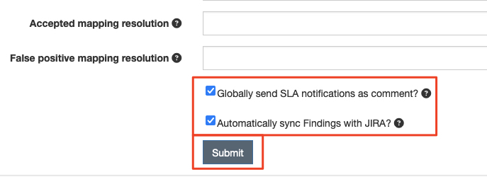
(DefectDojo) JIRA API Invocation Settings
앞 장에서 생성한 JIRA 토큰 입력
이 화면은 지라에서 이슈 하나를 임의로 생성하면 볼 수 있음
https://defectdojo.github.io/django-DefectDojo/integrations/jira/#adding-jira-to-dojo
https://shkim4u.atlassian.net/rest/api/latest/field
https://shkim4u.atlassian.net/rest/api/latest/issue/RWB-1/transitions

Slide 10
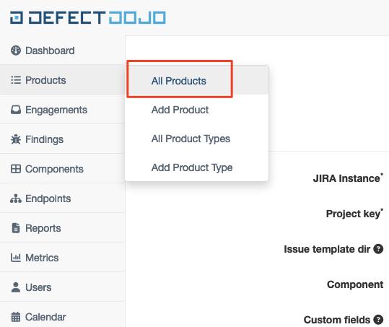
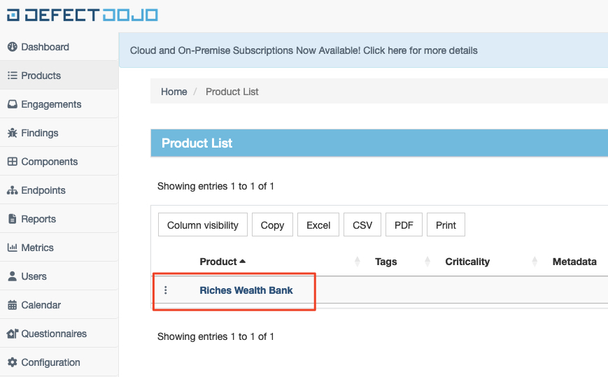
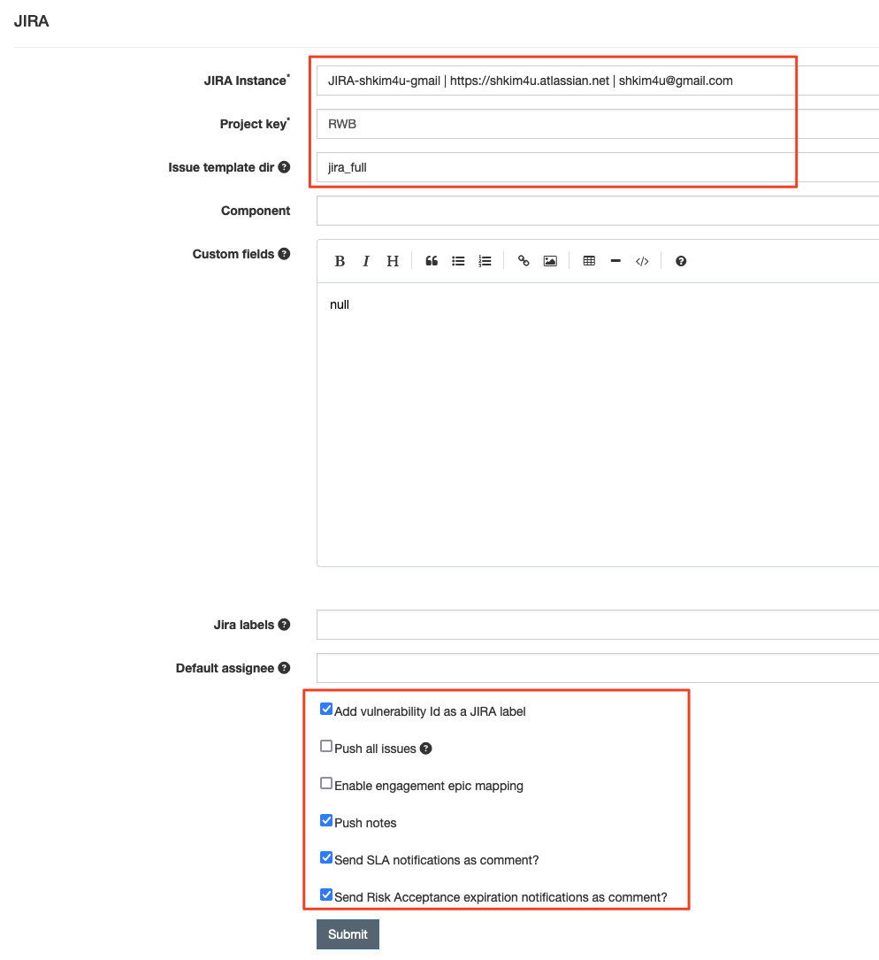
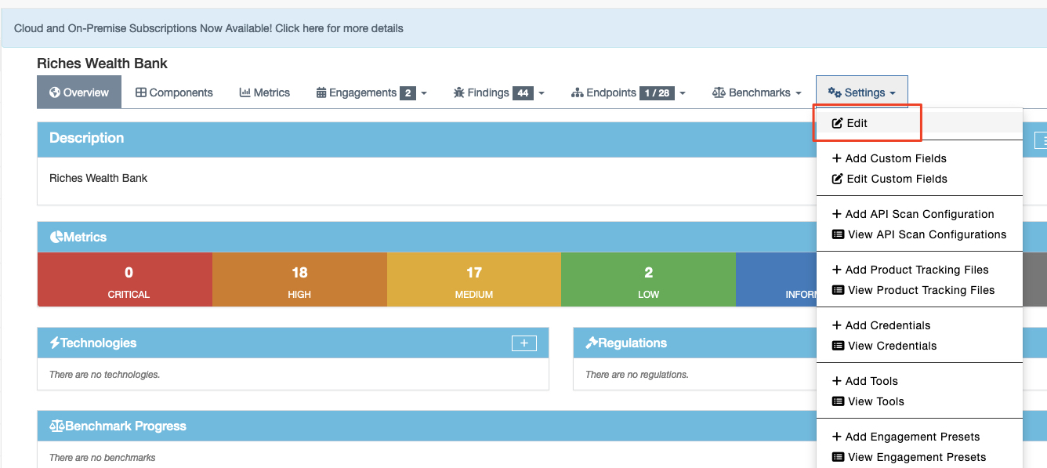
(DefectDojo) Product Settings

Slide 11
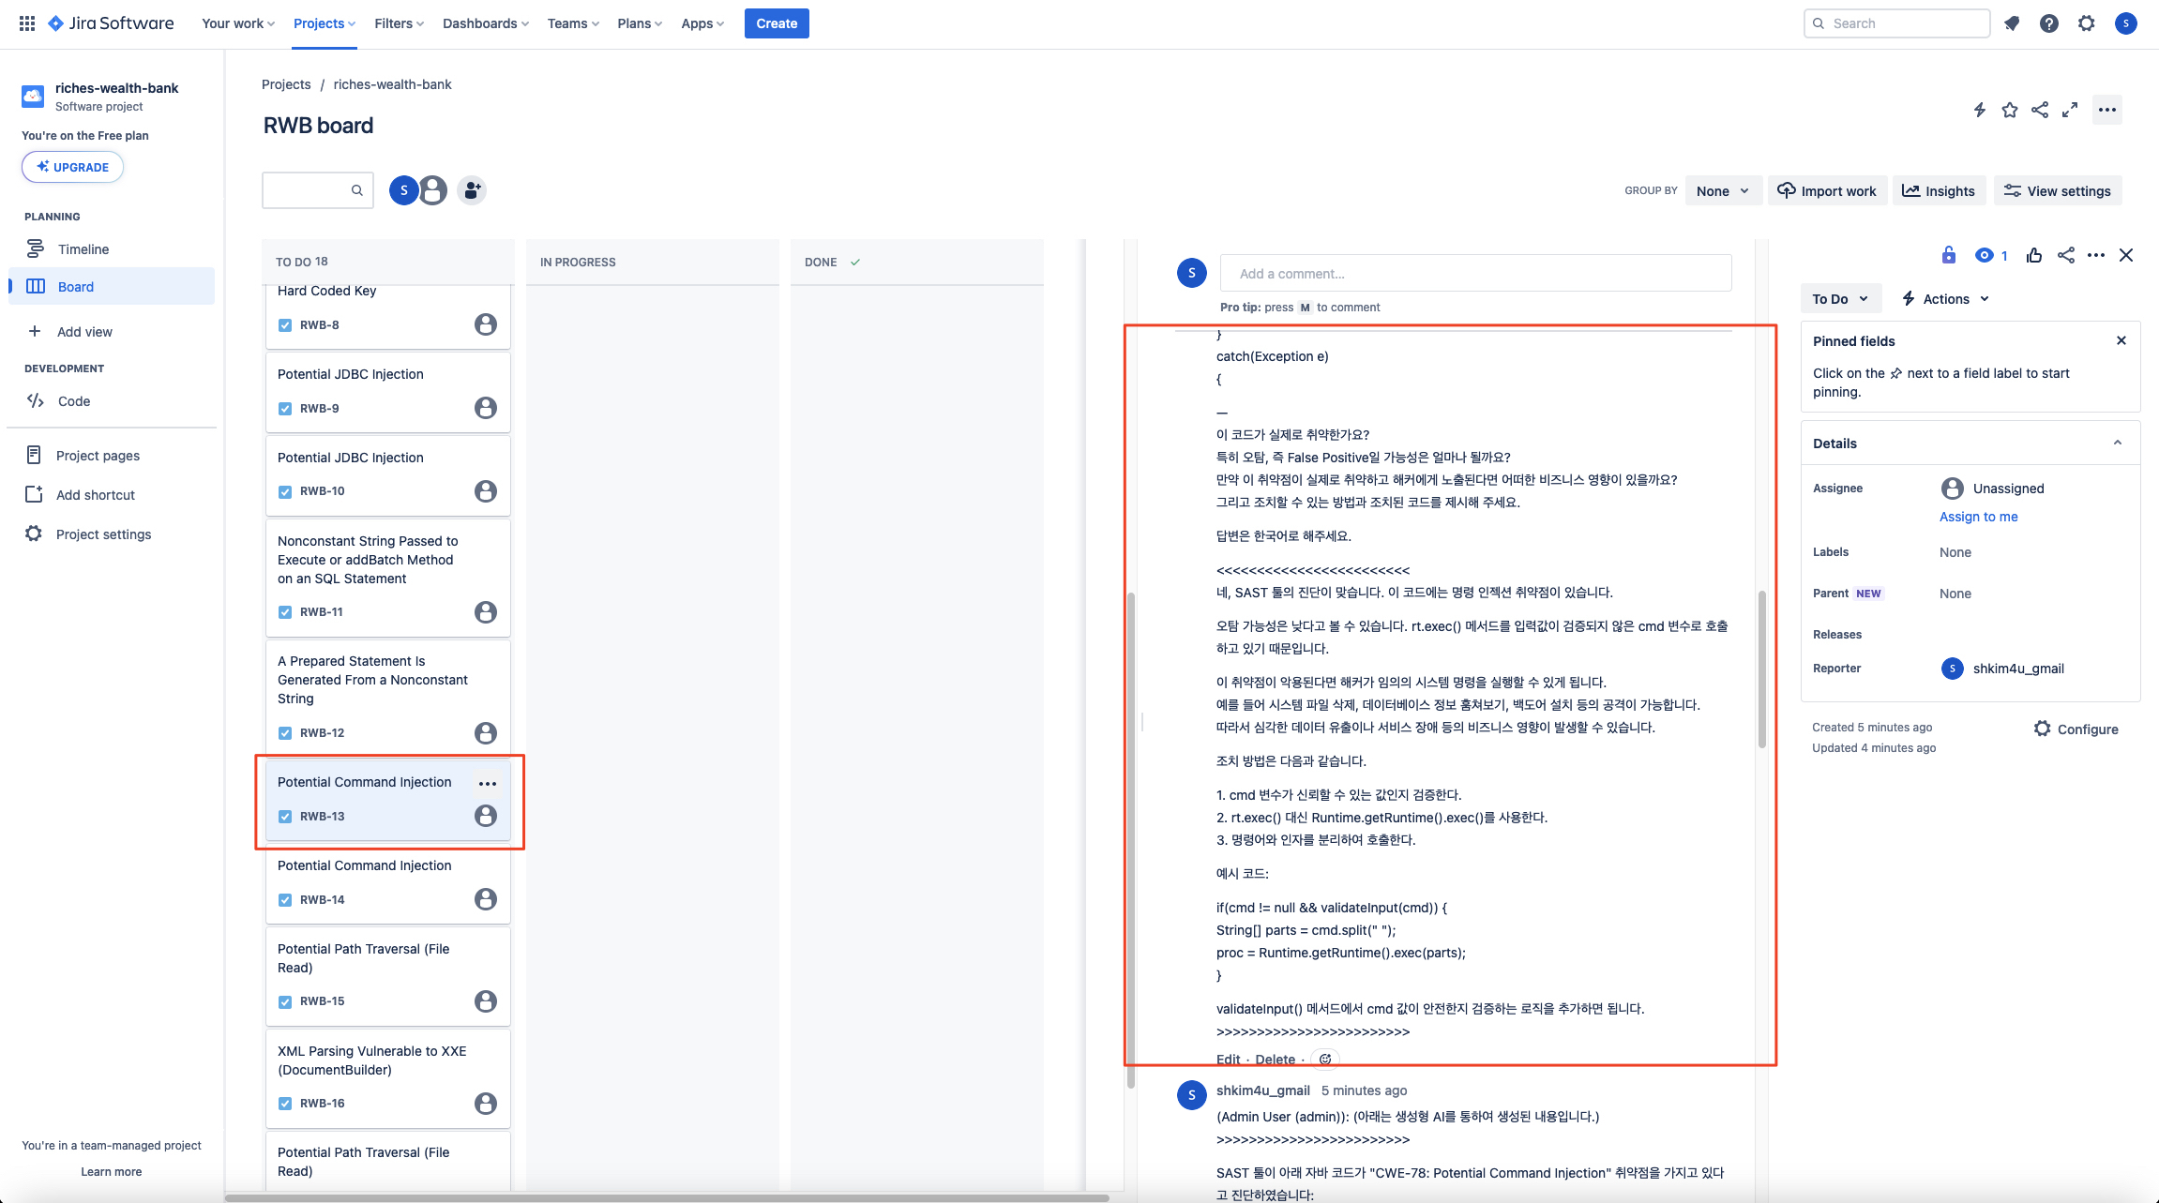
SAST Findings Pushed to JIRA

Slide 12
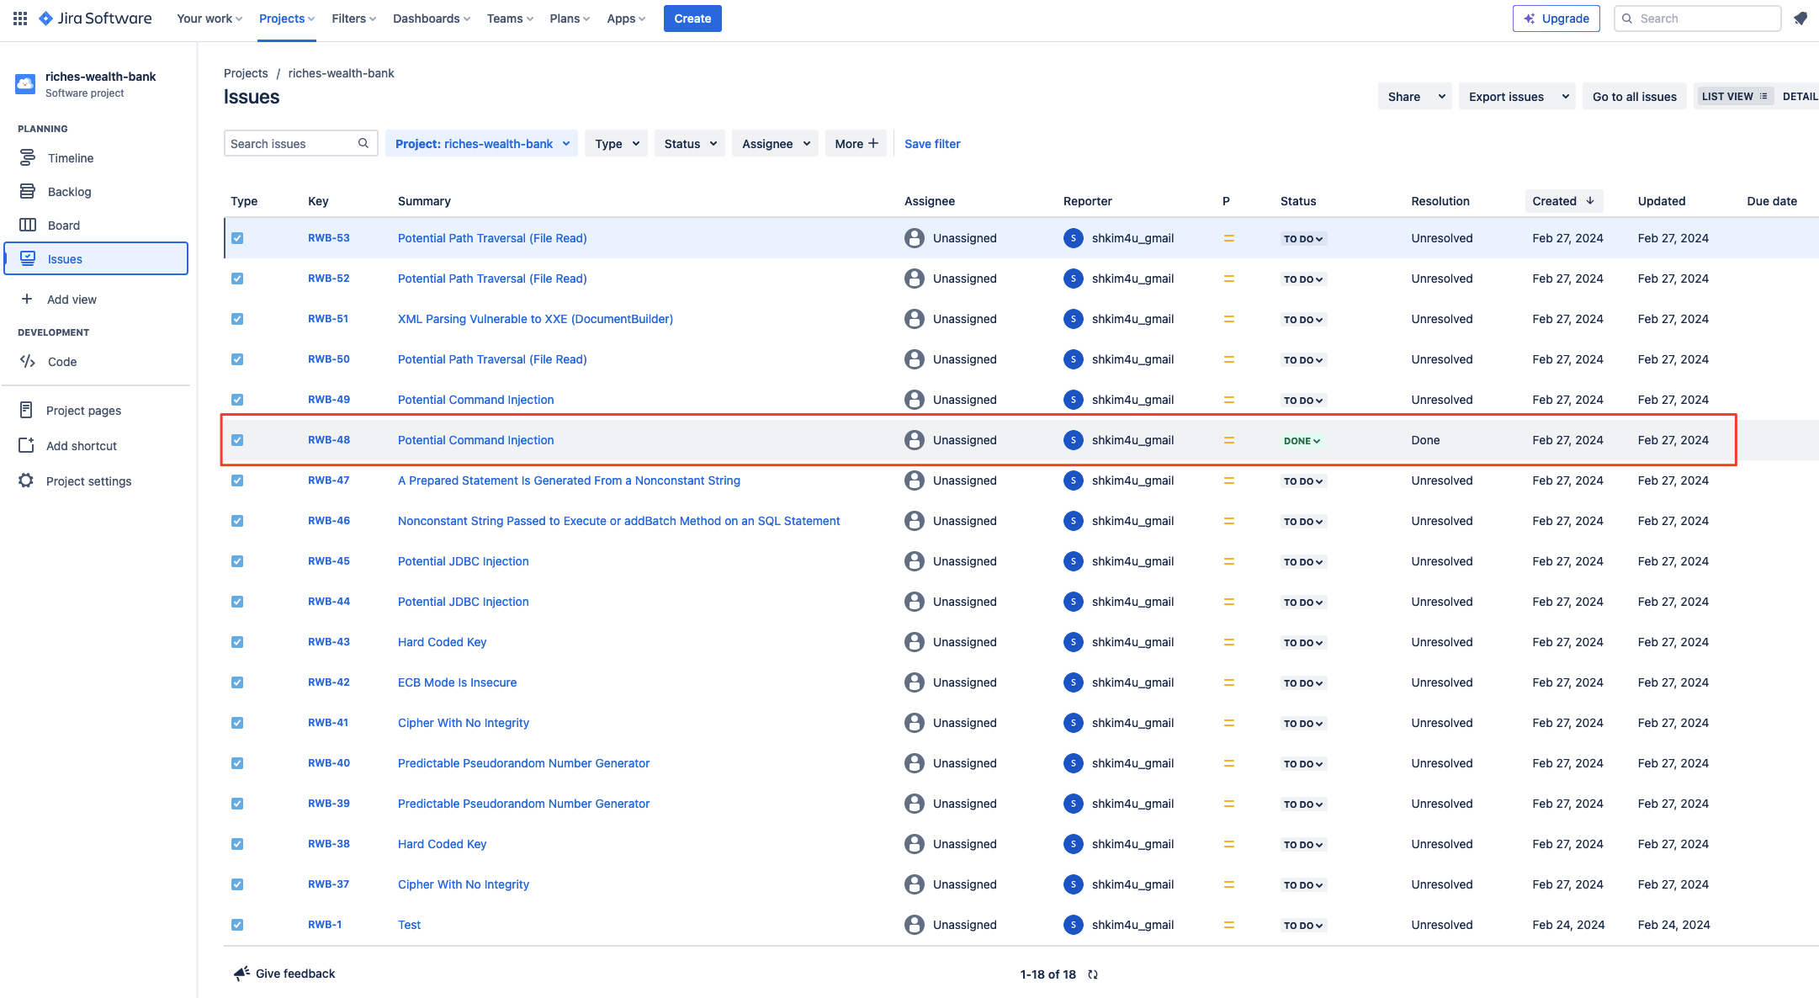
JIRA Issue Automatically Done when Remediated

